Slide 1

Volunteer ID
Every volunteer hour counts – forever

Slide 2

Problems with Volunteering in Romania
Only 3–8% of Romanians volunteer vs. ~20% EU average – bottom of the EU ranking
Paper certificates are fragile, easily lost, forgotten in inboxes, or manually faked
No instant verification: HR & universities can't confirm legitimacy
Volunteers stay invisible → no track record

Slide 3
Why it matters ?
Wasted Social Potential
Trust & Opportunity Gap
Low Retention Loop
With so few Romanians volunteering, countless community needs go unmet.
Employers, schools and funders can’t verify paper certificates, so real contributors miss jobs, credits and grants.
When effort isn’t tracked or rewarded, volunteers drop out, keeping participation rates stuck at the bottom of the EU.

Slide 4

01
The solution
After 5 hours of tree planting, you get a soul-bound badge on blockchain.

Slide 5
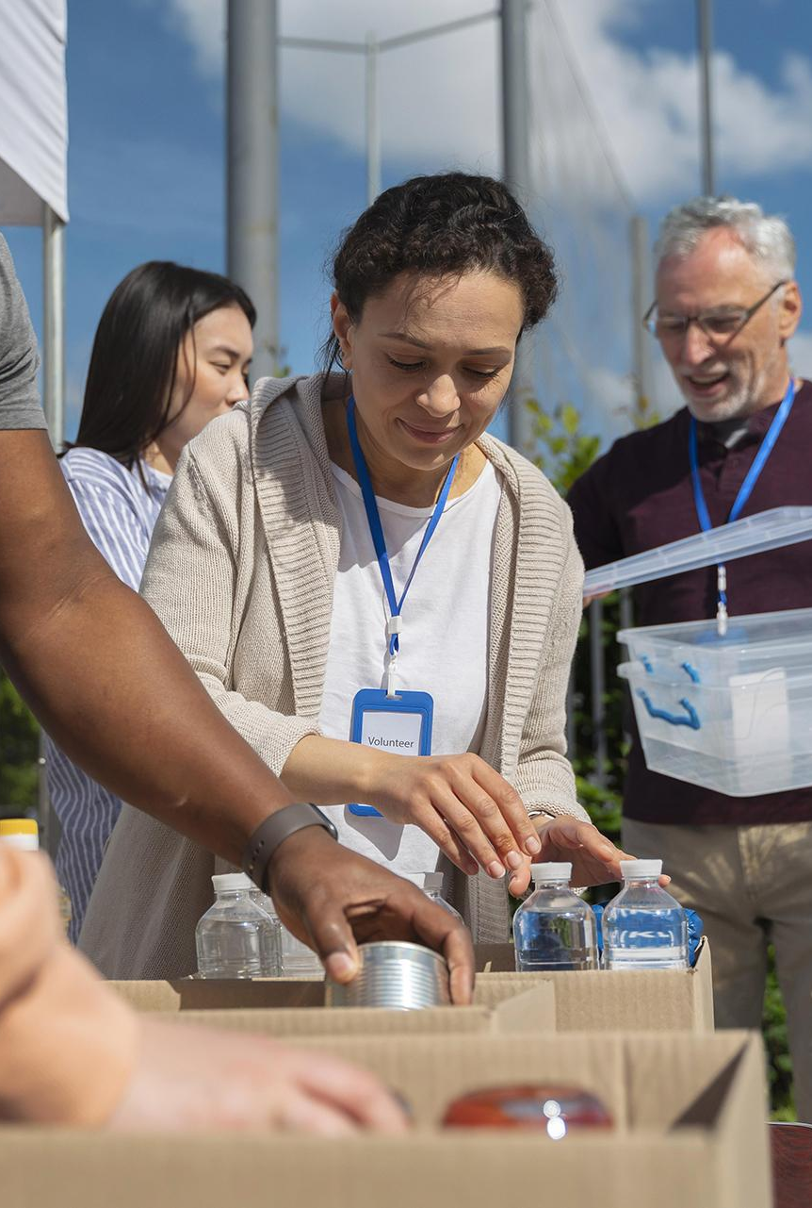
Key Features
01
02
03
Verified Impact
One digital badge / volunteer — immutable proof of every hour served
Instant Trust
Trusted by NGOs, employers, schools — no phone calls, no stamps
Motivation Engine
Gamified scoreboard builds community and rewards altruism

Slide 6
Why Blockchain and SBT
Public, tamper-proof ledger ⇒ no central registry to hack
Soul-Bound Token (non-transferable NFT) = cannot be sold or lost
No middlemen → instant verification, even years later
Read-only verification = 0 gas, 0 cost for recruiters
Excel + signature? → still forgeable & siloed
Protects volunteer identity → pseudonymous on-chain, encrypted off-chain

Slide 7
Impact
NGOs
Society
Easy hour tracking, transparent reports
Higher volunteer rate, environmental gains
Volunteers
2
3
Employers/Schools
Verified CV line, gamified milestones
Instant trust, no manual checks
1
4

Slide 8
Sustainability Model
 | Model | How it works | Why it fits
 | Event Sponsors Pay Gas | NGOs or event partners cover the small minting fee for each badge. | Keeps the experience 100% free for volunteers.
 | Impact Grants | We apply for grants from EU programs, Optimism, Gitcoin, or foundations. | We’re building a public good — it deserves public funding.
 | Optional Pro Features | Universities or companies can use a premium dashboard with premium features | Generates income without limiting access to the free public platform.

Slide 9
Technology / Architecture
Battle-Tested Solidity | 320 LOC, fully unit-tested, built on OpenZeppelin ERC-721 + AccessControl
Soul-Bound Enforcement | _update() override blocks all transfers except mint & burn
Role-Based Permission | ADMIN_ROLE & MINTER_ROLE secure NGO registration and badge issuance
Privacy-by-design | On-chain wallet + AES-hashed ID, off-chain encrypted JSON on IPFS
Gas-Optimized | 50 k gas per mint
Scalable | Events for The Graph; deployable on any EVM or Layer-2

Slide 10
Community
Volunteer Networks
Academic and Student Bodies
Corporate and Foundations
Collaborate with Local Volunteer Councils, Youth Volunteer Centers to drive mass adoption and gather on-the-ground feedback.
Partner with university career services, student unions & Erasmus+ coordinators to integrate Volunteer ID into credit-earning and internship programs.
Engage corporate volunteering programs and philanthropic foundations to sponsor minting fees and boost employee participation.

Slide 11
Traction
Launch tour at 3 high schools & 2 universities → onboard student councils and service-learning programs as early adopters.
Fully open-source on GitHub — pull-request-friendly repo, welcoming any dev and designer to join.

Slide 12

How Ocean Protocol would help
Public Dataset
Publish a clean, aggregated snapshot of your volunteer data as a Data NFT. Ocean hosts and indexes it—anyone can discover and verify your impact
Token-Gated Access
Ocean issues an ERC-20 datatoken for your dataset. You choose the policy—free paid, or volunteer-only—so on-chain tokens automatically control who can download the data.

Slide 13
Roadmap
NGOs join and start issuing badges.
Mobile app, sharing and rankings launch.
08/2025
10/2025
12/2025
2026
2026
First version live, first badges created
Volunteer data published on Ocean Market.
Employer checks and reward system added.

Slide 14
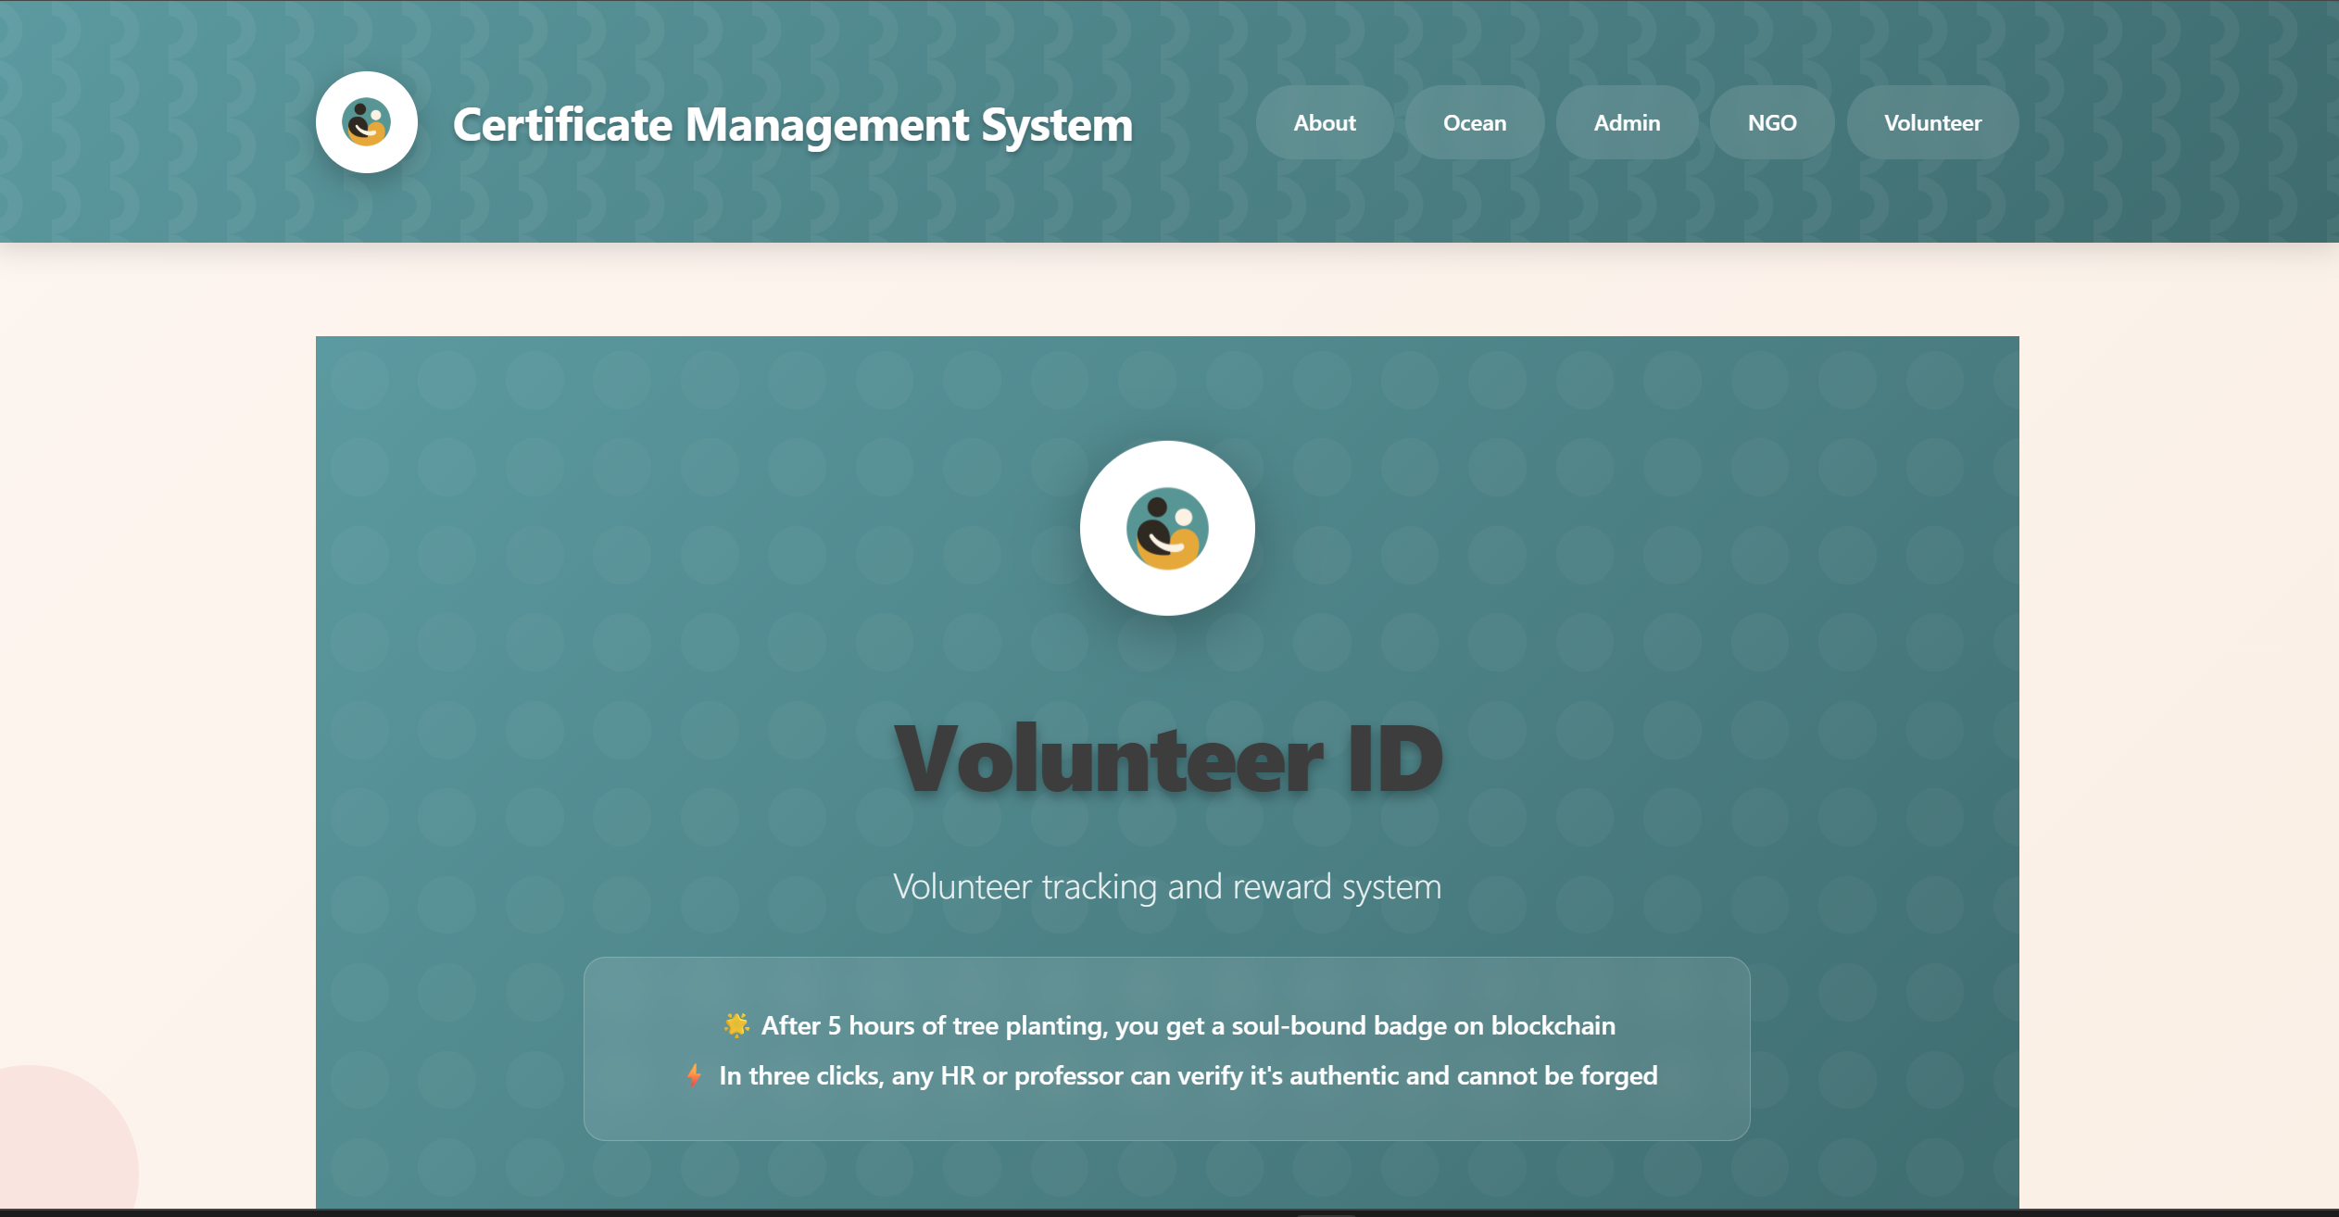
PRODUCT DEMO

Slide 15

THANKS!
DO YOU HAVE ANY QUESTIONS?
vonicapaul@yahoo.com
Linkedin.com

